Slide 1
NBA Performance & Betting Analysis
Ben Kessler, Tuukka Jaakkola , Jake Lamb, & Antonio Gutierrez

Slide 2
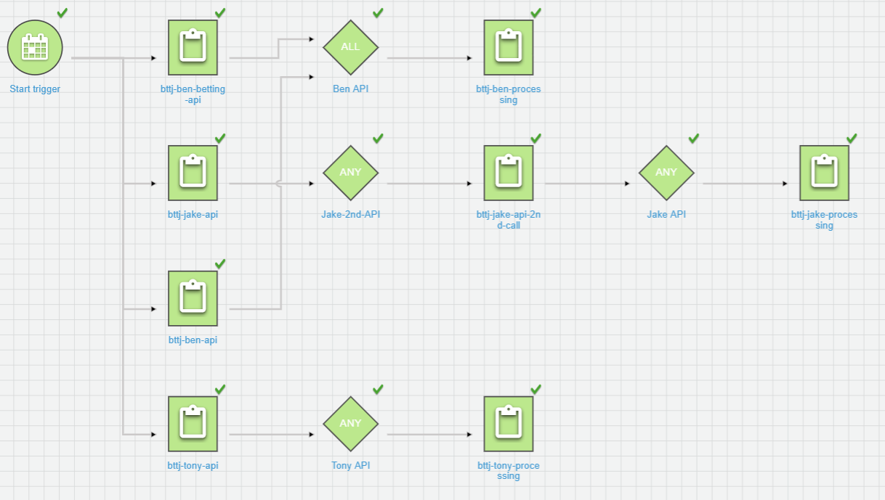
Workflow

Slide 3
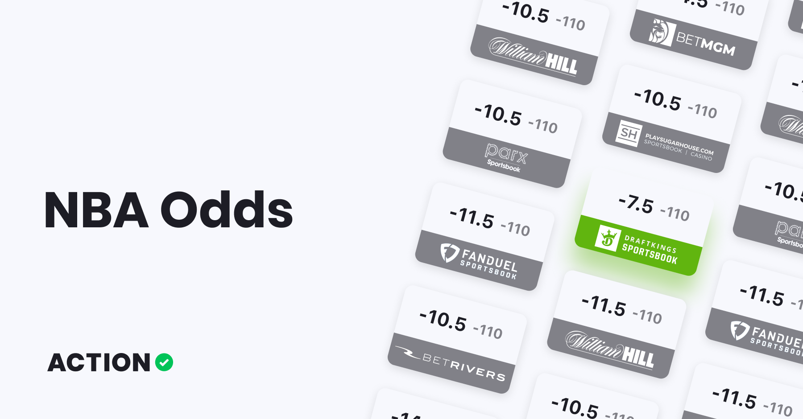
Hypothesis
Variability in a player’s performance impacts the individual bets made available to the public

Slide 4
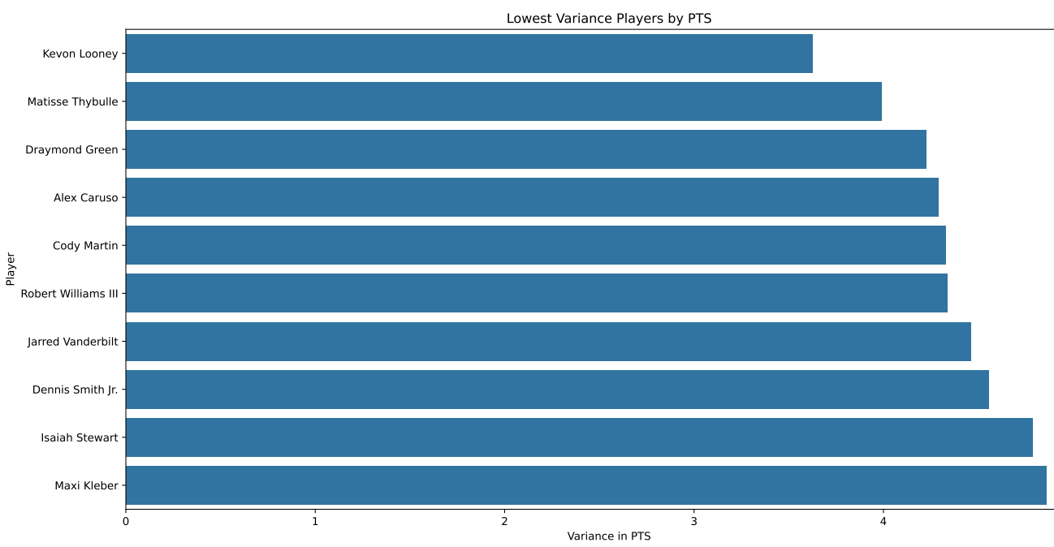

Slide 5
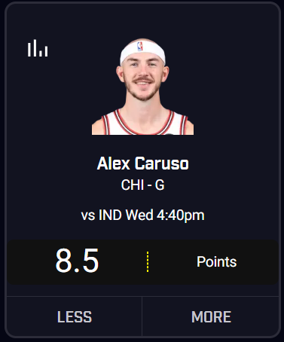

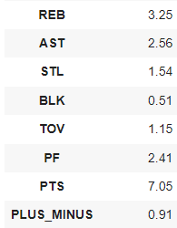
Example

Slide 6
Results
Using PrizePicks, you can bet on at 7 stat categories + combination of stats
Looking at the past two days, on average there were:
Only 4 instances where you could bet on low variance players (4/70) - 5.7%
19 instances where you could bet on high variance players (19/70) - 27.1%

Slide 7
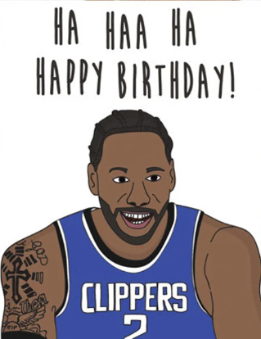
Player Birthday Analysis
Do younger players play worse in the games during the week following their birthdays than older players?
Some Definitions:
Younger Player: 25 and under
Older Player: Over 25
Stat Difference:
Average in the week after birthday - Average in the 45 days before birthday
Stats are per minute played
Negative values: Player played worse after birthday
Notes:
"Utilizing advanced analytical techniques, we aim to derive actionable insights that inform strategic decision-making and foster a data-driven culture."

Slide 8
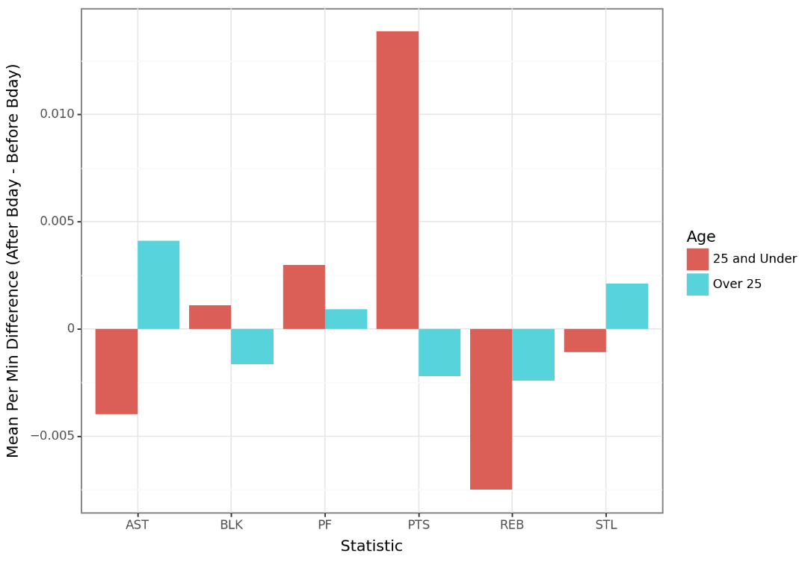
Looking Across the Last seven NBA regular seasons…
Percentage of Players who Performed Worse in each Stat
STATISTIC | 25 and Under | Over 25
Assists | 59% | 46%
Blocks | 54% | 58%
Points | 46% | 52%
Rebounds | 54% | 53%
Steals | 56% | 48%
Red: Younger Players had a higher Percentage
Blue: Older Players had a higher percentage

Slide 9
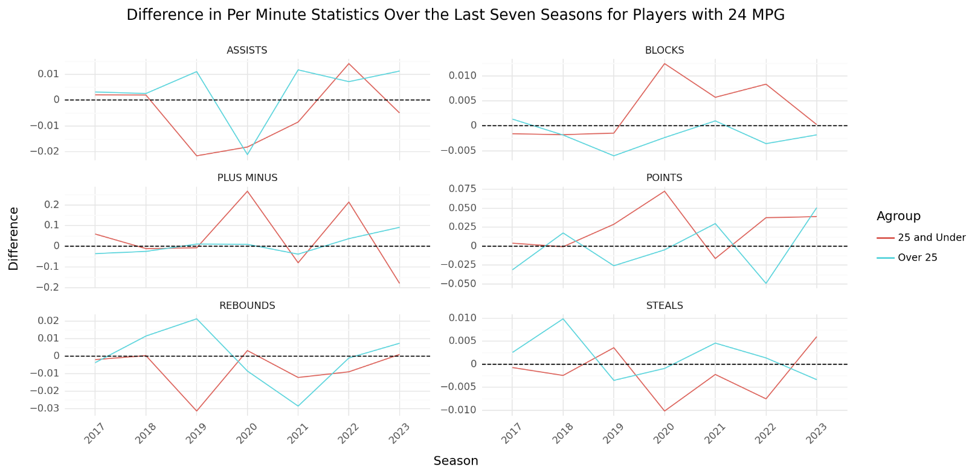
Looking At Year by Year Trends…

Slide 10
Some Terminology
Covering the Spread
The spread is a handicap assigned by oddsmakers to level the playing field between two teams
For example the Kings are -7.5 against the Lakers
To “cover the spread” the Kings would need to win by 8 or more or the Lakers would have to lose by 7 or less
Birthday Game
Defining a birthday game as any game that is within 1 day of any player on the team’s birthday
Out of the 8297 games, 2526 were birthday games

Slide 11
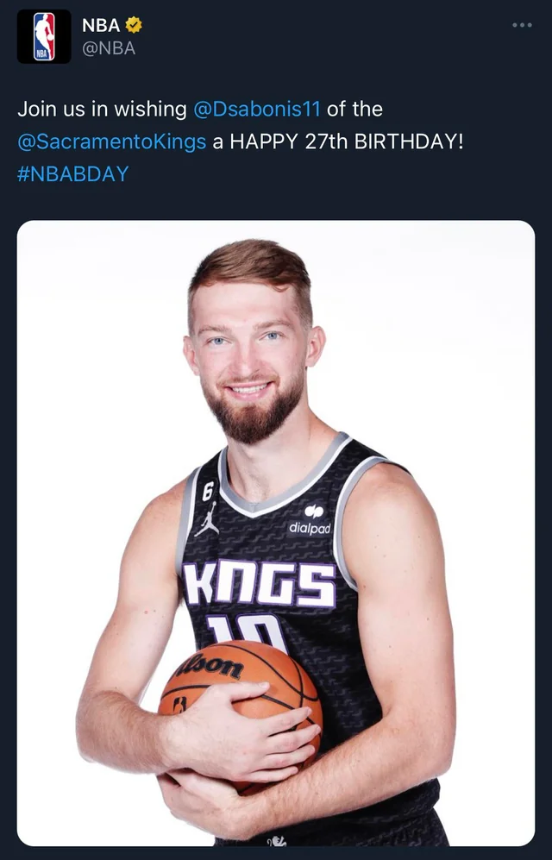
Team Birthday Analysis
Chi-Square Test of Significance
Three teams had a p-value of <.05
Bulls, Nuggets, Thunder
Three teams had a p-value of <.07
Pistons, Grizzlies, 76ers
Team t-test
Six teams with a p-value of <.05
Bulls, Nuggets, and Pistons played worse after a birthday game
Grizzlies, Thunder, and 76ers played better

Slide 12
Team and City Birthday Analysis
Team and City t-test
Taken with a grain of salt because of small sample sizes when examining team and city
P-values of <.05, most are <.01
Conclusion
Birthdays in big cities do not tend to cause most teams to play worse or better
Team | City | Team Performance
Houston | Denver | Better
Clippers | Phoenix | Better
Grizzlies | Houston | Worse
Bucks | New York | Better
T-Wolves | San Francisco | Better
Pelicans | Oklahoma City | Worse
Knicks | Boston | Better
Magic | Portland | Worse

Slide 13
ANY QUESTIONS?

Slide 14
THANKS!

